Slide 1
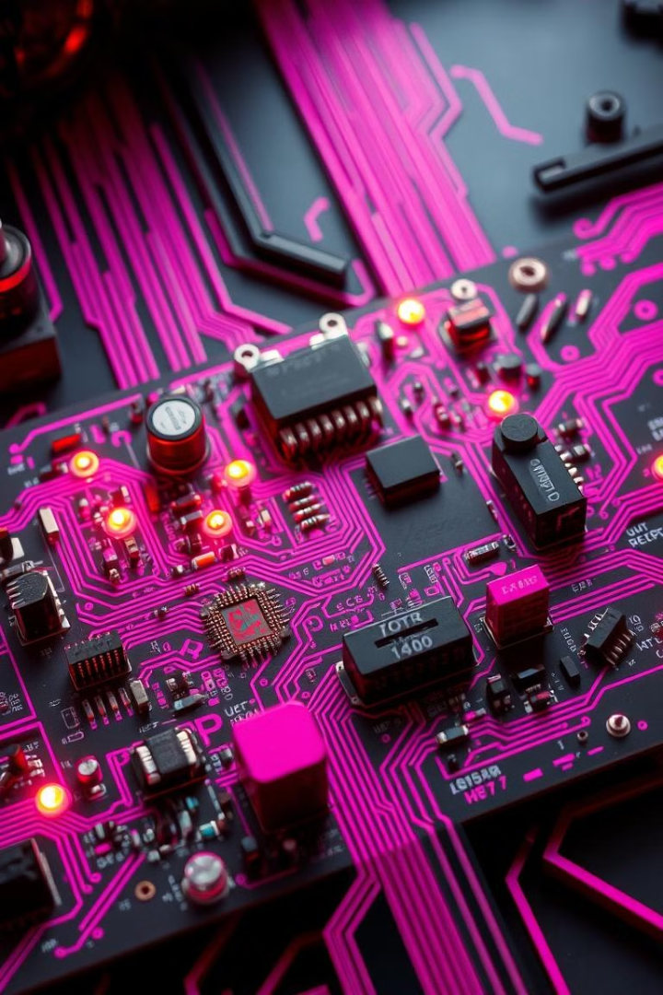

Introduction to Embedded Systems
Embedded systems are specialized computer systems designed for a specific task or function. They are often found in everyday devices, from smartphones and cars to medical equipment and industrial machines.
by Jeenal Khatri

Slide 2


Hardware Components of Embedded Systems
Microcontroller
Input/Output Devices
The heart of an embedded system, responsible for processing instructions and controlling the system's behavior.
Stores programs, data, and temporary information needed for the system's operation. RAM and ROM are common types.
Allow the system to interact with the external world, including sensors, actuators, and communication interfaces.

Slide 3
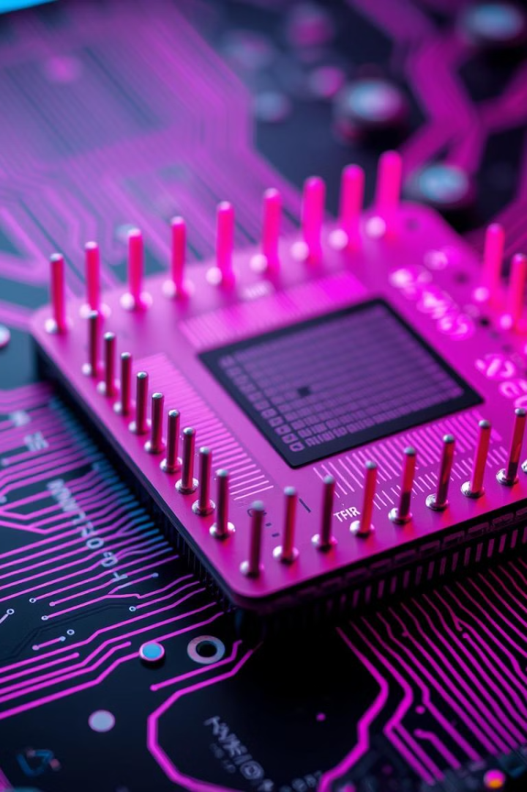



Microcontrollers and Processors
Microcontrollers
Processors
Small, integrated circuits designed for specific tasks, often featuring built-in memory, peripherals, and a processor.
More general-purpose computing units that handle complex tasks and can be customized with additional components.
Choosing the Right Processor
The selection depends on the specific requirements of the application, such as processing power, memory capacity, and I/O capabilities.

Slide 4




Embedded Software and Programming
Embedded Programming Languages
Real-Time Operating Systems
C, C++, and assembly are popular choices due to their low-level control and efficiency.
RTOS provide scheduling, memory management, and other services for embedded systems.
Device Drivers
Software that allows the system to interact with hardware components and peripherals.

Slide 5
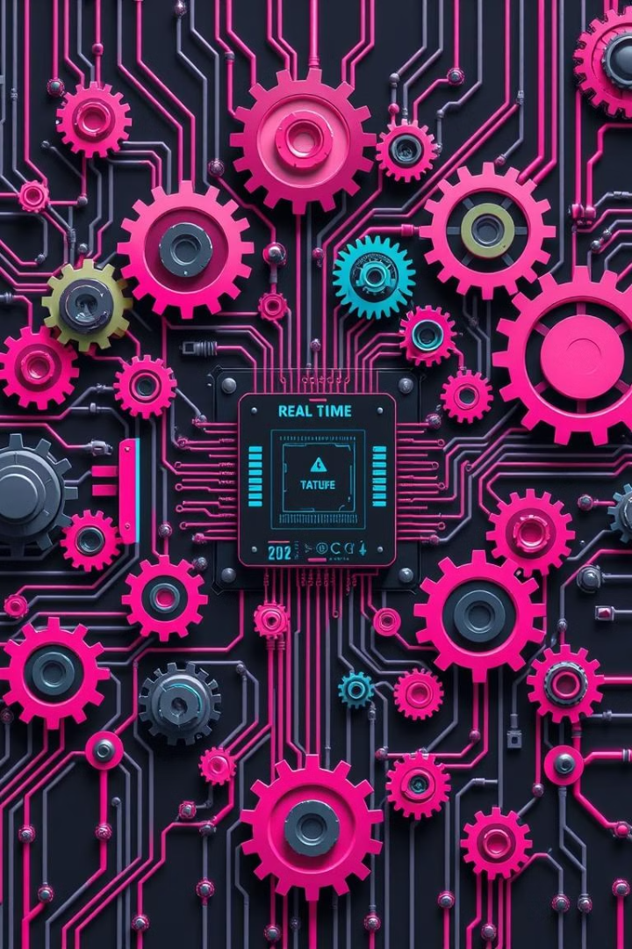
Real-Time Operating Systems
1
RTOS manage system resources, ensuring timely responses to events and predictable performance.
2
They provide a framework for scheduling tasks and managing memory, crucial for real-time applications.
3
Examples include FreeRTOS, uCOS, and VxWorks, each optimized for different performance and resource requirements.

Slide 6
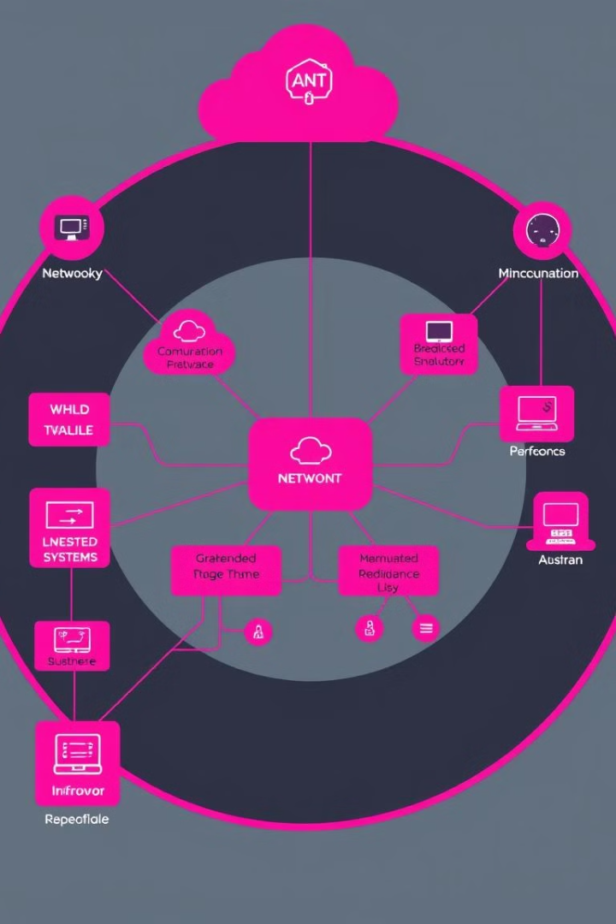
Communication Protocols and Interfaces
Serial Communication
Network Communication
Common for transmitting data serially, like UART, SPI, and I2C, used for interfacing with sensors, actuators, and other devices.
Embedded systems can connect to networks via Ethernet, Wi-Fi, or Bluetooth, enabling remote access and data sharing.
Other Interfaces
USB, CAN bus, and other specialized interfaces cater to specific needs, such as high-speed data transfer or automotive applications.

Slide 7






Embedded System Design Process
Requirements Gathering
1
Identify the system's functionality, performance, and limitations.
2
Hardware Selection
Choose suitable components based on requirements, considering cost, power consumption, and availability.
3
Software Development
Design, code, and test the software that drives the system's behavior.
Integration and Testing
4
Combine hardware and software, rigorously testing the system's functionality and performance.
Deployment and Maintenance
5
Deploy the finished system, ensure its long-term reliability, and address any issues that arise.

Slide 8



Challenges and Trends in Embedded Systems
Miniaturization
1
The demand for smaller, more compact devices presents challenges in component size and power consumption.
Connectivity
2
Embedded systems are increasingly connected, leading to complexities in security, data management, and network protocols.
Artificial Intelligence
3
AI is transforming embedded systems, adding capabilities for intelligent decision-making and autonomous operation.
Energy Efficiency
4
As devices become more powerful, the need for energy-efficient solutions is crucial, especially for battery-powered systems.

